Slide 1


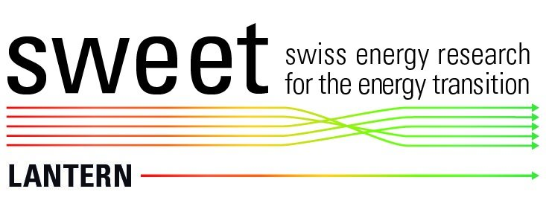
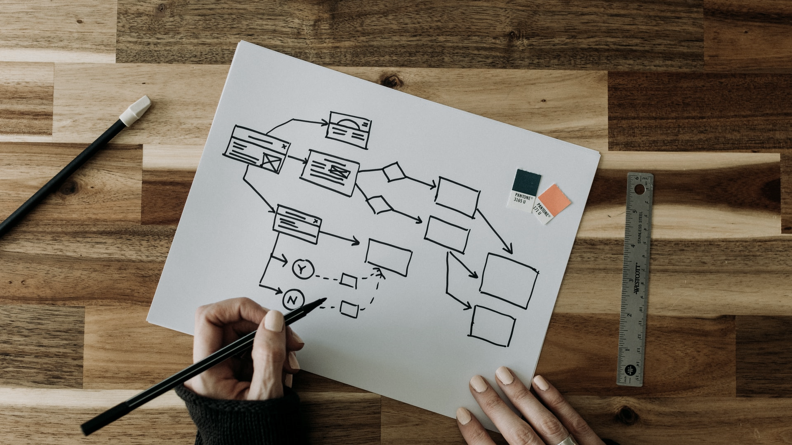

How to set up and develop a Living Lab & define a common vision ?
Module 1.3
Notes:
Hello and welcome to our Learning modules developed by the University of Applied Sciences in Western Switzerland.

Slide 2
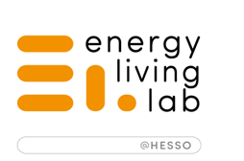
Program Structure
MACRO level
MESO & MICRO levels
Module 1.1
Module 1.2
Module 2.1
Module 2.2
Living Lab Approach and Stakeholders Ecosystem Management
Governance Models
Design Thinking and Integrative Living Lab Process
Empathise and Define
Module 1.3
Module 1.4
Module 2.3
Module 2.4
How to set up and develop a Living Lab and define a common Vision
Defining the roles within the Living Lab
Ideation and Co-design with users
Prototyping and Testing the solutions
Module 1.5
Module 1.6
Module 2.5
Module 2.6
Business Models
Open Innovation legal aspects and IPR
Experimentation and Scaling up
Evaluating performance
Notes:
We are in the Module 1.3 where we will discuss how to set up and develop a Living Lab and define a common vision.

Slide 3
A quick review of Module 1.2
Definition
A governance model is a structure to assist the management in fulfilling its governance roles.
Types of Governance Models
Department of a Research Center
Non Profit Organisation
Public Regional or City Structure
Private company
Cluster
Mutualistic Organisation
Notes:
In the previous Module, we studied the Governances Models, their types, and characteristics. We also looked at examples from different countries.

Slide 4
Contents
Value creation
Common Vision / Mission / Values / Goals
Setting up a Living Lab
Developing a Living Lab
Notes:
We will have a closer look at how your living lab can create value for its stakeholders. What you need to think about and what are the main challenges.

Slide 5
Value creation
Notes:
Let’s continue to have a deeper look at Value creation and it’s components.

Slide 6

Living Labs create value for:
End-users (events, projects, services for citizens)
Private companies (consulting services)
Public administration (testing arenas, sharing tools & methodology)
Other Living Lab (knowledge exchange)
Source: The NEWCOMERS project, 2010
Notes:
Living Labs create value for different groups of stakeholders. These could be the end-users of projects and services proposed by a Living Lab, as well as private companies, public administration or other Living Labs.

Slide 7






6 dimensions of value
Political
Technological
Economic
Environmental
Social
Legal
Notes:
The value creation and driving motivation could be represented by 6 dimensions, which are Political, economic, social, technological, environmental and legal. A PESTEL model can be used to help identify these dimensions. The importance on these dimensions could vary according to the specific projects. For example, for the 2iSECAP project, on the creation of integrated Climate and Energy plans, the priorities are for the environmental, technological and political values. And for the Lantern project, the social and economic values are also important to consider.

Slide 8
Political value
Policy recommendations ;
New policies and laws ;
Political mobilisation.
Greater public engagement
Awareness-
raising
Influence on
new policies
Community
empowerment
Community leadership
Notes:
Political value creation concerns mainly the new policies and laws. It represents a sort of political mobilisation to achieve greater public engagement and faster changes, for example in the field of energy and climate transition.

Slide 9
Economic value
Monetary benefits for customers and shareholders ;
Optimization of processes to lower the production or storage cost ;
Creating local jobs and contracts, community and shareholder income.
Income
generation
Income
retention
Saving money
on energy bills
Tackling energy poverty
Local jobs
creation
Notes:
The economic value represents the classical view on value creation, but it focuses more on the business models of private organisations and cooperation partners. It could be described by getting the monetary benefits or process optimization, to lower costs, as well as creating new jobs and contracts.

Slide 10
Social value
Learning and awareness-raising ;
Empowerment of stakeholders by:
  Active participation and stimulation ;
  Social entrepreneurship ;
  Local ownership and decision-making
Social Innovation
Increasing social
cohesion/inclusion
Increasing
trust
Improvement
of community wellbeing
Alleviation of energy poverty
Enhancing
energy literacy
Notes:
Social value creation can be defined by learning, awareness-raising and empowerment of stakeholders with the help of active engagement, participatory activities and other methods of increasing social cohesion and innovation.

Slide 11
Technological value
Technology helps the members to:
  Lower their carbon footprint ;
  Trade the produced energy ;
  Empower them to be more active in their energy use and production.
Notes:
The next type of value creation represents the value created with the help of technologies. Particularly in the energy sphere, it's also defined by how users and organisations lower their carbon footprint, how the is energy produced and distributed, as well as the level of stakeholder engagement.

Slide 12
Environmental value
Sustainability ;
Lowering the carbon footprint ;
Use of green technologies and sources of energy.
Notes:
Environmental value creation is more concerned with sustainability issues, lowering the carbon footprint and use of greener technologies or energy sources and other environmental benefits.

Slide 13
Legal value
Legal framework (ex. the development of knowledge about IP rights and IP left among the community to protect their ideas by InnoBooster Switzerland) ;
Open licences and open innovation ;
Legal operations and skills.
Notes:
Legal value covers legal frameworks, operations and skills, as well as questions of open licences and open access to projects and services.

Slide 14
What added value will your Living Lab bring to its stakeholders?
bringing different stakeholders together
creating projects in a collaborative way
proposing innovative solutions to existing processes
allowing experimentation and co-creation
Notes:
What Added Value will your Living Lab bring to its Stakeholders? For example : bringing different stakeholders together in a community of practice? Or creating projects in a collaborative way? Proposing innovations to improve existing processes? Or perhaps allowing experimentation and co-design with different actors?

Slide 15
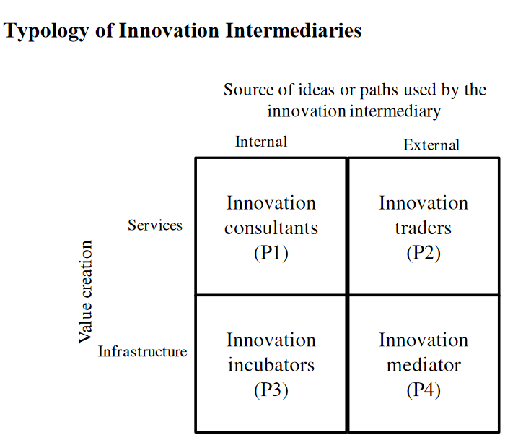
Innovation Intermediaries
Lopez-Vega & Vanhaverbeke, 2009. https://mpra.ub.uni-muenchen.de/27017
Notes:
An “innovation intermediary” is defined by Chesbrough as an organization that speeds up the quest for possible solutions to a customer’s problems by drawing on broader sources of ideas and by helping inventors find firms interested in their inventions (Chesbrough 2006).
Living labs can be described as innovation intermediaries, providing an important role in value creation. There are different types of innovation intermediaries:
Innovation consultants provide innovation services, relying on internal sources of knowledge, to solve specific innovation problems or requests.
Innovation traders screen and provide access to a large amount of external ideas and innovations, relying on a platform of innovation solvers, to facilitate the identification of potential scientific and business oriented solutions.
Innovation incubators provide infrastructures to facilitate the internal exchange of ideas and knowledge among firms searching to conduct science, technology or business activities.
Innovation mediators provide infrastructures to facilitate the use of external ideas and knowledge coming from users, entrepreneurs, R & D institutes, to established firms searching to find science, technology and business opportunities. (Lopez-Vega & Vanhaverbeke, 2009) https://mpra.ub.uni-muenchen.de/27017
If the innovation intermediaries correspond to the specific criteria of the European Network of Living Labs (ENoLL), they could ask to be certified by ENoLL.

Slide 16
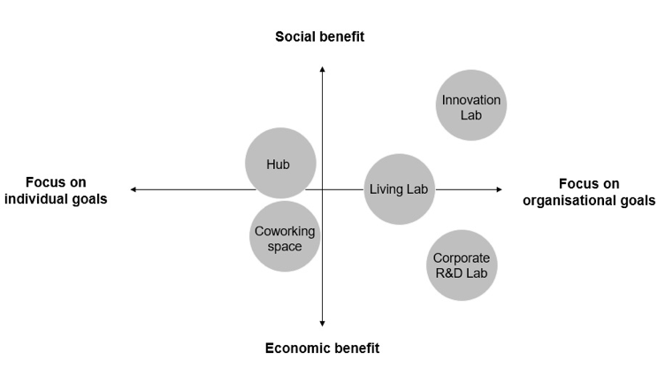
What type of innovation lab should you choose?
Fuzi, A., Gryszkiewicz, L., & Sikora, D. (2018). A spectrum of urban innovation intermediaries: from co-working to collaboration. In ISPIM Conference Proceedings (pp. 1-6). The International Society for Professional Innovation Management (ISPIM).
Notes:
The innovation intermediaries can also be described depending on the type of value or benefit (broadly social or economic) and their focus (organisational or individual). A Living lab is focussed on organisational goals and provides a balance between social and economic benefits.

Slide 17

Common Vision / Mission
Values / Goals
Notes:
Now let's move on to the next part and discover what could be the mission/vision/values and goals of your LL and why it is important to think about it from the start.
A key role of the LL is to offer a moderated environment to define together a common vision and align the stakeholders.

Slide 18


Vision vs Mission
The vision statement focuses on tomorrow and what the organization wants to become.
The mission statement focuses on today and what the organization does.
Notes:
Let's start by defining the difference between the vision and the mission statements. The vision focuses on tomorrow and what the organization wants to become. The mission focuses on today and what the organization actually does. To be active in the long term, a Living Lab as an organisation should have both a Vision and a Mission. One doesn’t work without the other, because having a vision for the future is as important as understanding how to achieve it, and what you need to do today.

Slide 19
Vision
A vision statement describes where the Living Lab wants a community, or the world in a broader sense, to be as a result of its actions and projects.
Gives direction
Aspirational
Promotes growth​
What are our hopes and dreams?
What problem are we solving for the greater good?
Who and what are we inspiring to change?
https://unalab.enoll.org/vision-development/
Notes:
So, the vision statement gives the direction. It is the future of your Living Lab, It is aspirational and it's about what you want to become.

Slide 20


Vision Statement >> WinLab of Winterthur
<<With WinLab, the city of Winterthur wants to position itself as a real-world living lab to test in systematic ways social and technological innovations supporting the smart sustainable city development especially in the context of the energy and climate concept aiming at net zero by 2040>>
Vicente Carabias & Marisa Kappeler-Schudel
Smart City Responsibles
City of Winterthur & ZHAW
Notes:
Here is an example of the Vision statement of WinLab in the city of Winterthur, Switzerland. Winlab is a partner in the SWEET Lantern Project.

Slide 21
Mission
A mission statement clarifies what the organisation wants to achieve, who they want to support, and why they want to support them.
Clearly described
Precise
Open for everybody​
What do we do?
Whom do we serve?
How do we serve them?
Notes:
A mission statement answers the WHY question, clarifies what your Living Lab wants to achieve, who you want to support, and why you want to support them. It should be clear, precise and open to everybody.

Slide 22
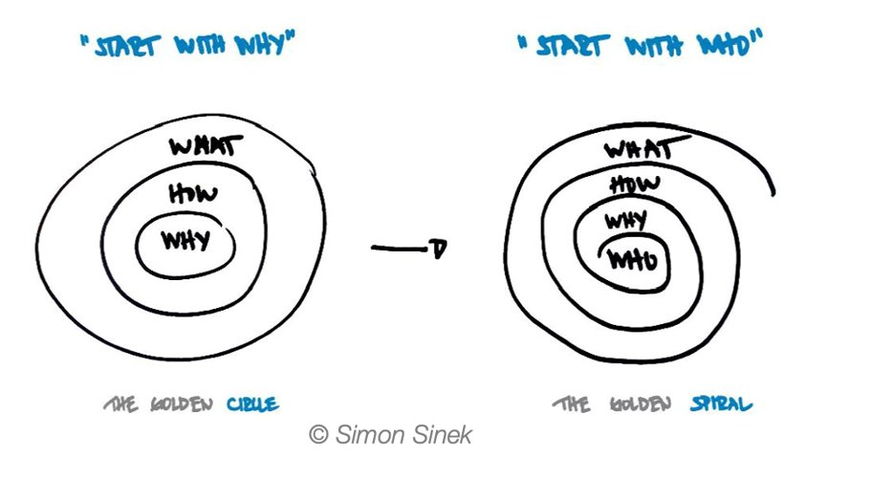
How to create a Mission Statement?
Notes:
To develop the Mission Statement you could use the methodology known as the Golden Circle, a principle developed by Simon Sinek. Start with the why and consider the how and the what. Rethink what you have said by restarting with the who at the centre of your mission. Expand the Golden Spiral into why, how and what. This will help you to develop your mission and vision statement.

Slide 23
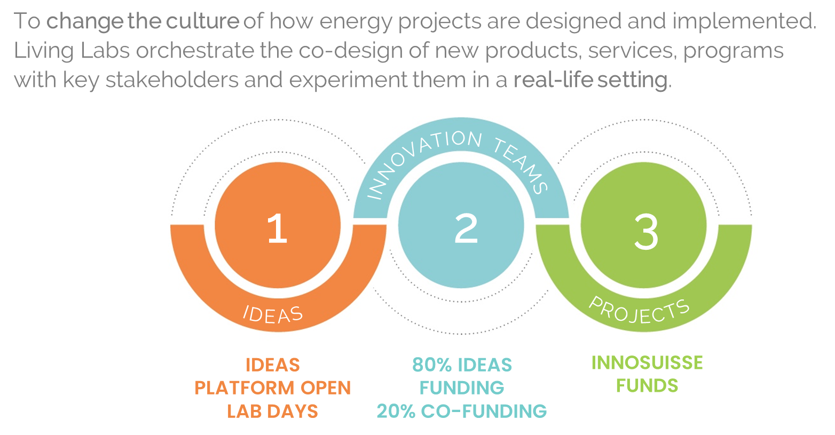
Mission Statement – example from the Innovation Booster – Living Labs for Decarbonisation
Notes:
To give you an example, here you'll find a statement of "why" and a diagram illustrating "how" of one of the project – Innovation Booster, Living Labs for decarbonisation.

Slide 24

Business has a key Role in leading the Transformations that the World needs
WBCSD
Notes:
Business has a key Role in leading the Transformations that the World needs, inspirational examples can be found in the WBCSD programme called Visions 2050.

Slide 25
How to create a common vision? Role of a Living Lab
The role of a Living Lab is to align vision and mission, as well as interests and values.
Interest 1
Interest n-1
Common vision
Interest n
Notes:
It can take a long time to align on a common vision amongst stakeholders. The vision may change over the time and evolve as more partners engage with the Living Lab through different projects. Its important to have clear communication for onboarding new stakeholders. It is the role of the Living Lab to orchestrate the ecosystem of actors, to understand their interests and influence and to facilitate the exchanges towards a common vision. This can be done through workshops and participative events using a variety of methods and tools. Excellent communication and facilitation skills in the core Living Lab team are key competencies required for success.

Slide 26
Living Lab strategy
Mission / Vision
Values >> what are the key shared values
within your LL?
Goals >> what are your main long/middle/short-term
goals and how they will be measured?
Notes:
After completing your vision and mission statement you can also think about the values, goals and resources required to develop your Living Lab.

Slide 27
Setting up a Living Lab
Notes:
Let’s discover together how to set up your Living Lab.

Slide 28
Why setting up a Living Lab?
To have a structured organisation where different stakeholders could join their forces to innovate, co-create and implement solutions
To have a collaborative community environment for multiple activities engaging citizens, private and public sectors into the co-design process;
To have a methodological approach to work on the projects using the holistic approach.
Notes:
So, why set up a LL? First, to have a structured organisation where different stakeholders could join their forces to innovate, co-create and implement solutions. Then, to have a collaborative community environment, for multiple activities engaging citizens, private and public sectors into the co-design process, as well as to have a methodological approach to work on the projects using a holistic approach.

Slide 29
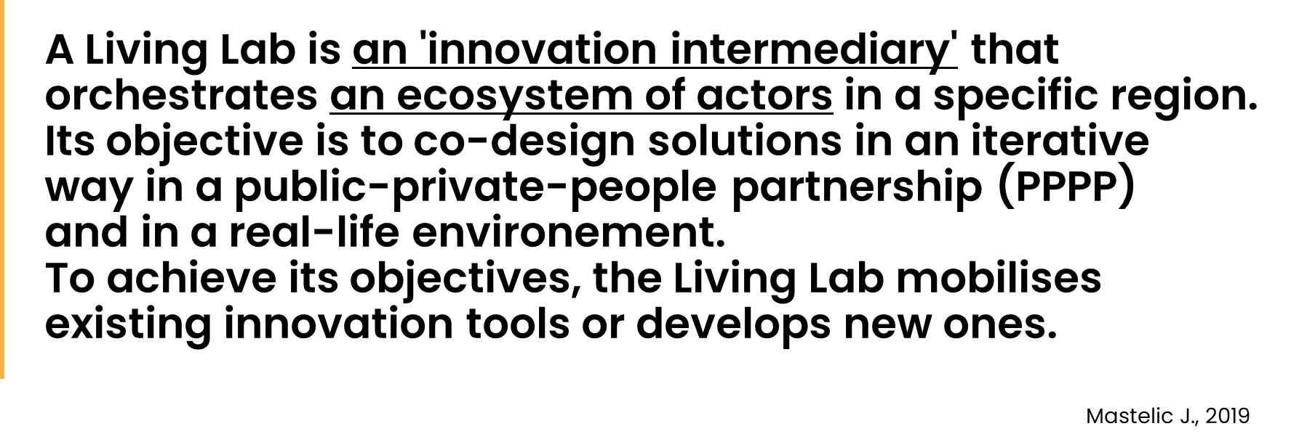
Emergence of Living Labs
  a project is not a Living Lab
  Long term viability of a Living Lab is supported through:
  a diverse ecosystem of actors
  a clear governance model and written agreements
  a business model delivering societal value
Notes:
Let's quickly return to the definition of the Living Lab.
It should be mentioned, that a Living Lab often starts with one single project and develop its activities across a portfolio of projects over the time. However, remember that a project is not a Living Lab.
The long-term viability of a Living Lab is supported through: establishing a rich and diverse ecosystem of actors, a clear governance model and written agreements, and a business model delivering societal value.

Slide 30
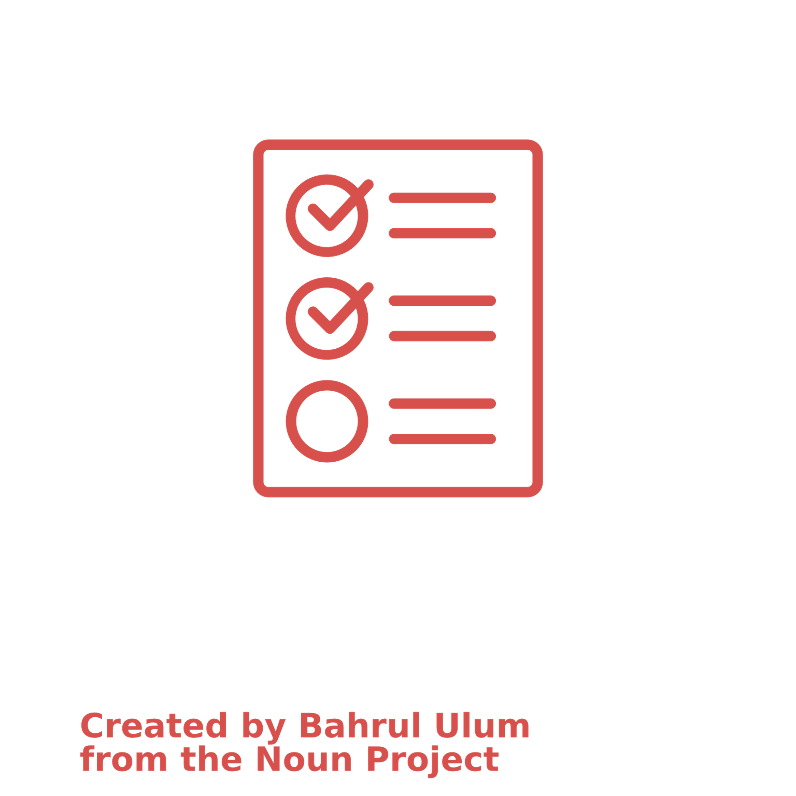
Important questions for setting up a LL
What are your vision, mission, values and goals?
Who are your main stakeholders?
Which wicked and complex problems are you trying to solve?
Why do you need a Living Lab and not another type of intermediary?
What activities will your Living Lab provide to whom?
What financial, material, human resources do you need?
Who will be in your core team and what competencies will they have?
What will be your participative governance model?
What are the key aspects of your business model?
How to ensure the viability of your Living Lab in a long term?
Notes:
Here you'll find some important questions to ask yourself to support the successful set up of your LL.

Slide 31
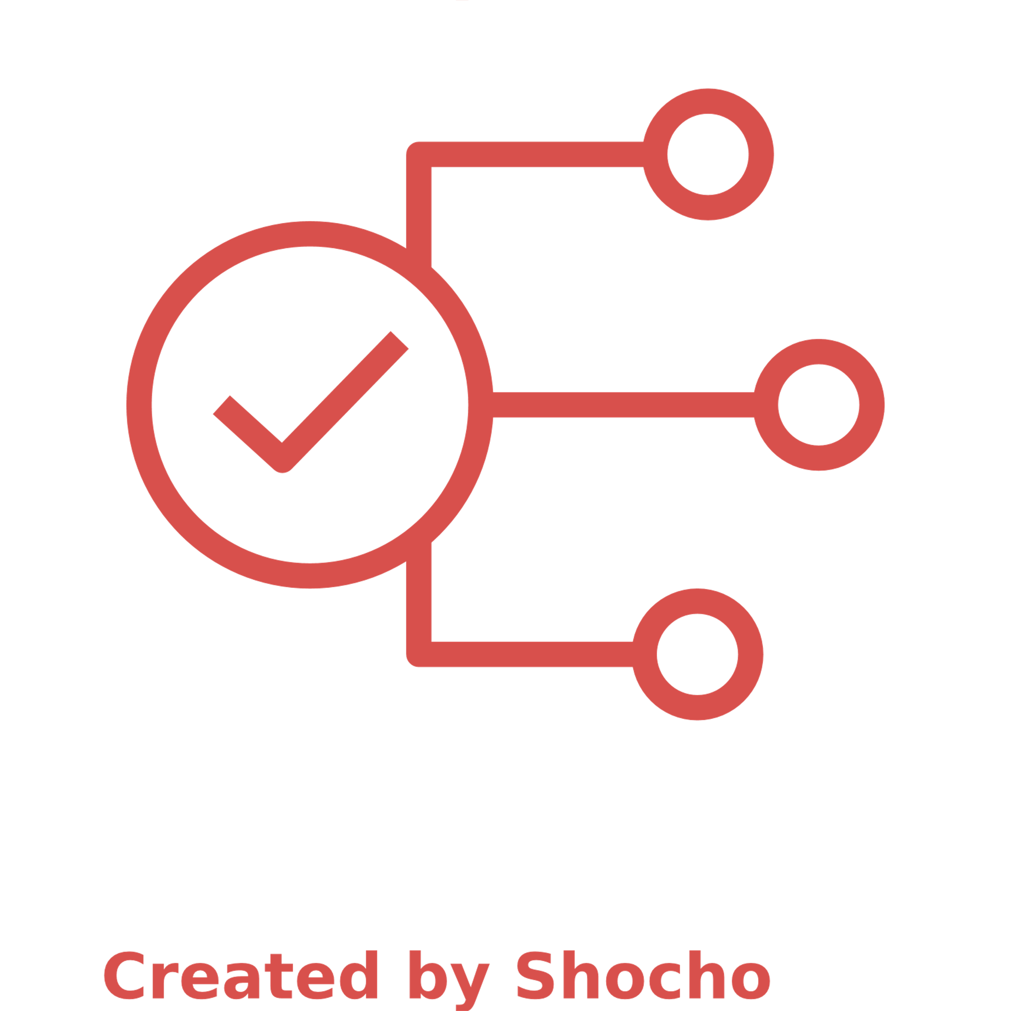
Structured approach for launching
Disseminating solutions
Scoping /
Analysing
Managing / Monitoring
Planning
Launching
Lessons learned
Notes:
So, to launch and manage your LL, you can refer to this step by step process involving, scoping, planning, launching, monitoring, lessons learned and the dissemination of solutions.

Slide 32
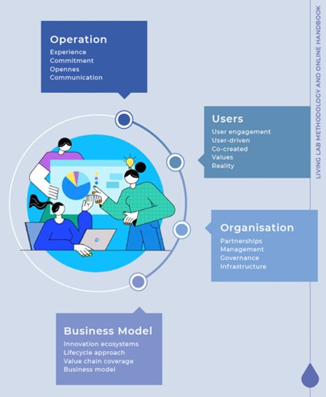
Living Lab Activities
Who? Why? How? What?
Users
Operation
Organisation
Business model
Example of REWAISE Handbook
http://rewaise.eu/wp-content/uploads/2022/05/REWAISE-LL-online_handbook.pdf
Notes:
When setting up a Living Lab, it’s essential to think of the who, why, what and how of your structure. We will explain this here in some more detail.
Who: consists of considering different roles within the Living Lab taking into account that interdisciplinary collaboration is proven to foster innovations. The Living Lab team could include such roles as a Living Lab Manager, Project Manager, Pilot Manager, Panel Manager, Human Interaction specialist. A communication manager is also an very important role.
Why: includes creating a common vision of your Living Lab, thinking about its values and goals.
How: covers rules, processes, methods and tools used to develop solutions. Numerous tools have been developed to facilitate the co-creation process, many of which are listed in the next chapters.
What: aims to define different fields, projects and activities of the Living Lab. For example in the Lantern Project, the fields are Smart Energy users, Energy at Work, Mobility, Energy Communities and Coopératives, Affordable and Efficient Housing, and Sustainable recreation and tourism.

Slide 33
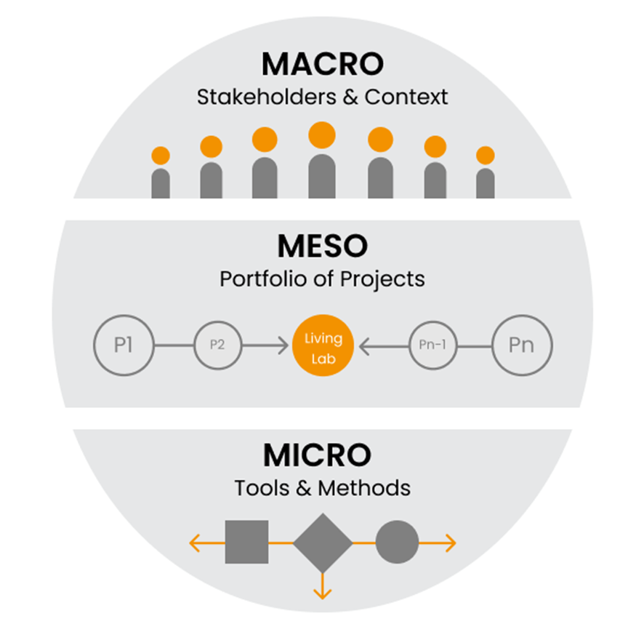
Methodological Approach
To set up the Living Labs we use a multi-layers' approach.
  MACRO level – Setting up the ecosystem and structure of the Living Lab – Institutionalisation
  MESO Level - Delivering projects through the Living Lab Integrative Process
  MICRO Level – Using various co-design tools and methods depending on the projects
Notes:
The Living Lab Framework and Methodology is derived from learnings of many EU projects and through the ENoLL Network. One of the key frameworks is the 3 layer model of Macro, Meso and Micro, where the macro level is the stakeholder (or landscape), the Meso level is the Project (or Regime level), where innovations are developed using a design thinking process, for example the Living lab Integrative Process. And the Micro level where methods and tools are used at different stages of the innovation process. The methods and tools will differ depending on the requirements of the Living Labs and Projects.
For example, in the 2iSECAP Project this holistic approach is used to set up 6 Living Labs to co-design Integrated Energy and Climate action plans. In the Lantern Project this approach is used to set up and develop 6 Energy Living Labs in Switzerland to drive social innovation in several energy related themes.

Slide 34
Developing a Living Lab
Notes:
Let’s discover together how to further develop a Living Lab.

Slide 35
How to keep a Living Lab Alive?
Value creation: find your value proposition
Time dimension: think of the evolution of your Living Lab​
Viability in a long term: develop a solid Business Model​
Lessons learned: rethink strategy over time
Mastelic, J., Sahakian, M., & Bonazzi, R. (2015). How to keep a living lab alive?. info, 17(4), 12-25.​
Notes:
How to keep a Living Lab alive?
Value creation – find your unique Value Proposition
Time dimension – think of the evolution of your Living Lab over time
Viability in a long term – develop a Business Model, using for example the Liaison Business model canvas.
Lessons learned – rethink and adapt your strategy over time.

Slide 36
Evaluation of the Living Lab
Lifecycle approach
Value chain analysis
SWOT-analysis of a Living Lab
Roadmap for the future
Notes:
Evaluating the impact and success of the Living Lab can be both qualitative and quantitative. A lifecycle approach using long term planning and the identification of risks can be helpful. A value chain analysis can be used to evaluate the Living Lab especially for proof of integration of the Living Lab into innovation ecosystems. A SWOT-analysis of a Living Lab can help to analyse and inform the evaluation. A roadmap for the future can be a useful tool to show the outcome of the evaluation.

Slide 37
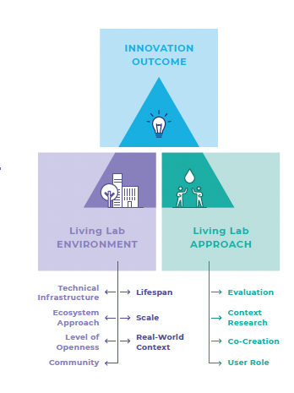
Impact of Living Labs
Veeckman, C., Schuurman, D., Leminen, S., & Westerlund, M. 2013. Linking Living Lab Characteristics and Their Outcomes: Towards a Conceptual Framework. Technology Innovation Management Review, 3(12): 6-15
Notes:
There are many approaches to measure impact of Living Labs, both at the Macro and meso levels. The theory of Change is an important framework enabling the development of indicators and showing the impact of specific interventions at the project level.
The Living Lab Triangle framework studies the interplay between the setup of the living lab environment (macro level) and the impact of the projects within the lab (meso level). This model triangulates the characteristics of the living lab environment, the living lab approach, and the innovation outcome. The living lab environment shapes the projects undertaken and thus the innovation outcome.

Slide 38
Capacity Building Opportunities
  Virtual learning Lab – ENoLL
  E-learning videos and modules - 2ISECAP
  Capacity Building Handbook - oPEN Lab
  Capacity Building Handbook - REWAISE
  Energy Living Lab Association (ELLA) – Swiss Community
Notes:
Capacity Building Opportunities are very important for the success of a Living Lab. A mix of learning material such as e-learning, presentation and interactive workshops appeal to a diverse audience.
Several capacity building options are currently available such as:
The Virtual Learning Lab from ENoLL,
Project specific Learning Modules developed by HES-SO, for example for 2ISECAP project
The capacity building Handbook developed for the oPEN Lab and REWAISE projects,
And the Energy Living Lab Association which focussed on dissemination of learnings.
More research is needed on knowledge transfer to understand how people learn in Living Labs.

Slide 39
Bibliography
Horwath, R., & Drucker, P. (2005). Discovering purpose: Developing mission, vision & values.
Strategic Thinking Institute, 1-9.
Grusenmeyer, D. (2009). Mission, vision, values & goals.
Bowen, S. A. (2018). Mission and vision. The international encyclopedia of strategic communication, 1-9.
Mastelic, J., Sahakian, M., & Bonazzi, R. (2015). How to keep a living lab alive?. info, 17(4), 12-25.
Mirvis, P., Googins, B., & Kinnicutt, S. (2010). Vision, mission, values. Organizational Dynamics, 39(4), 316.
Hakkarainen, L., & Hyysalo, S. (2013). How do we keep the living laboratory alive? Learning and conflicts in living lab collaboration. Technology Innovation Management Review, 3(12).
Bart, C. K., & Baetz, M. C. (1998). The relationship between mission statements and firm performance: An exploratory study. Journal of Management Studies, 35, 823–853.
Bart, C. K., Bontis, N., & Taggar, S. (2001). A model of the impact of mission statements on firm performance. Management decision, 39(1), 19-35.
Von Wirth, T., Fuenfschilling, L., Frantzeskaki, N., & Coenen, L. (2019). Impacts of urban living labs on sustainability transitions: Mechanisms and strategies for systemic change through experimentation. European Planning Studies, 27(2), 229-257.
Annica Kronsell & Dalia Mukhtar-Landgren (2018) Experimental governance: the role of municipalities in urban living labs, European Planning Studies, 26:5, 988-1007, DOI: 10.1080/09654313.2018.1435631
Timo von Wirth, Lea Fuenfschilling, Niki Frantzeskaki & Lars Coenen (2019) Impacts of urban living labs on sustainability transitions: mechanisms and strategies for systemic change through experimentation, European Planning Studies, 27:2, 229-257, DOI: 10.1080/09654313.2018.1504895
Schuurman, D., & Tõnurist, P. (2016). Innovation in the public sector : exploring the characteristics and potential of living labs and innovation labs. In Proceedings of the OpenLivingLab Days 2016, Montreal, Canada (pp. 78–90). Montreal, Canada.
Notes:
Here you'll find some useful sources if you want to go deeper into the topic.

Slide 40


Thank you for your attention
Joëlle Mastelic
Professor HES-SO
President of Energy Living Lab Association, CH
joelle.mastelic@hevs.ch
Anastasia Ponomareva
Research Associate, HES-SO, CH
anastasia.ponomareva@hevs.ch
Fiona Zimmermann
Senior Research Associate, HES-SO, CH
fiona.zimmermann@hevs.ch
Notes:
Thank you for your attention. In the next Module we will have a closer look at different roles within the Living Lab.

